Slide 1
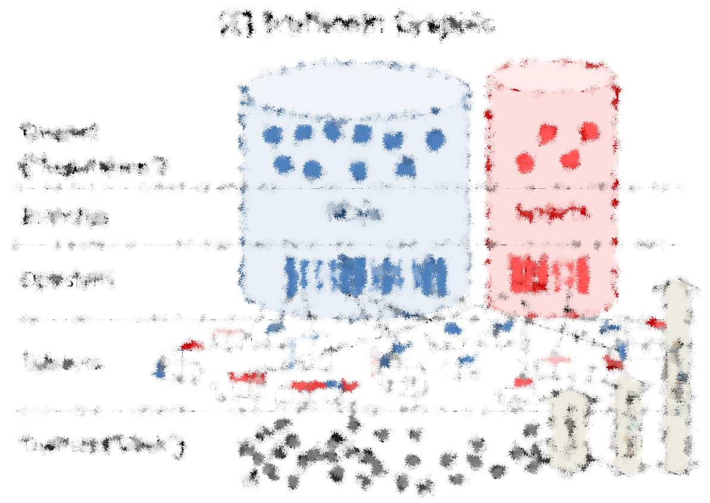
What is Hivemind?
Three existing ideas…combined!
Paul Sztorc
Version 1.0
BitcoinHivemind.com
I don’t own any of the images used in this presentation. They were freely taken from the internet and are used only for educational purposes.

Slide 2
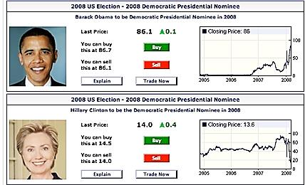
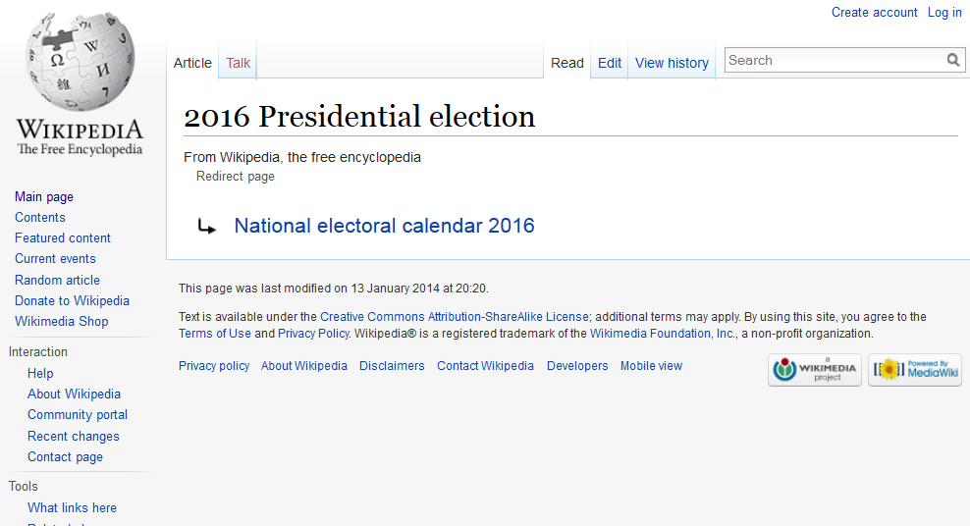

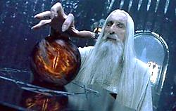
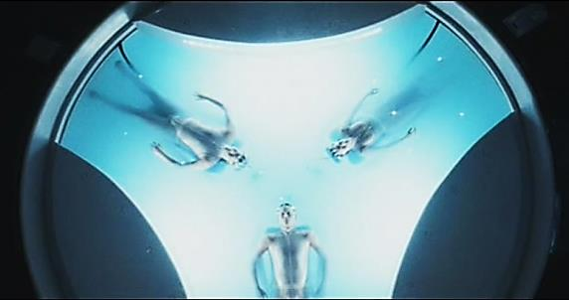
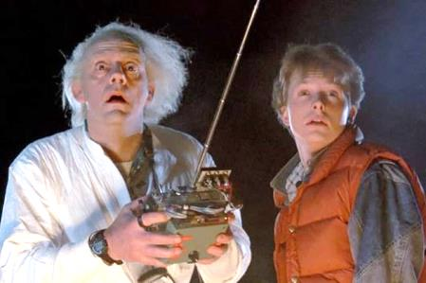

Three existing ideas…
A ‘stock market’ for a special kind of derivative.
A kind of ‘Future Wikipedia’.
A software protocol.

Slide 3
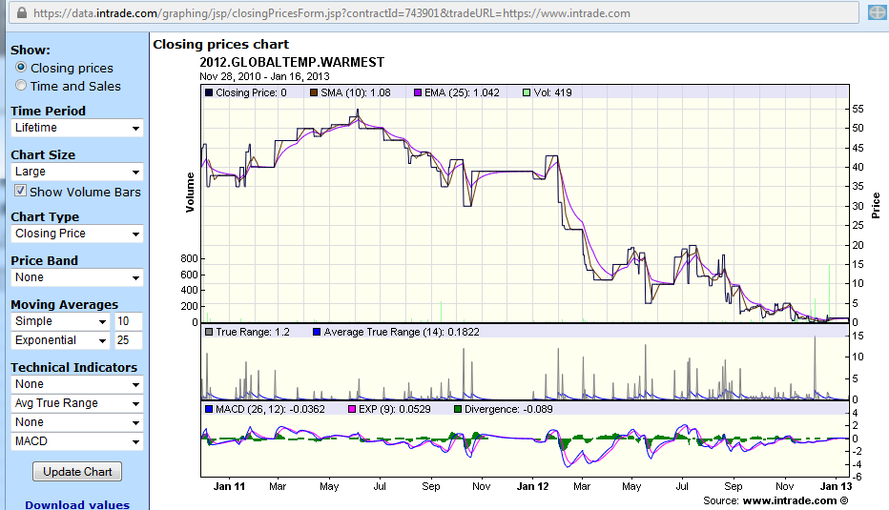
1. A ‘stock market’ for a special kind of derivative. Below: event derivative (InTrade.com) on 2012 global warming
Worth $100 if 2012 is the warmest year on record.
Ran from Jan 2011 to End of 2012

Slide 4
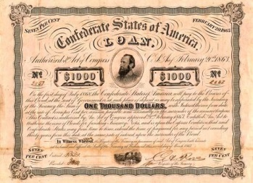
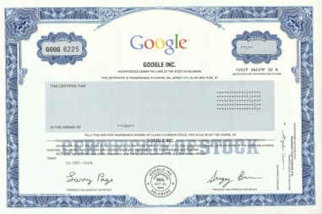
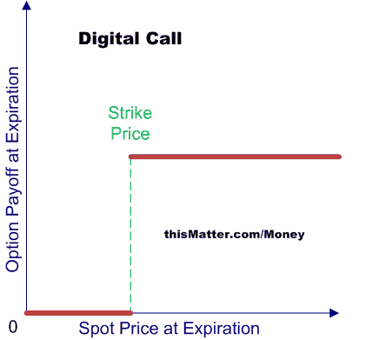

Event Derivative? What’s that??
Finance Thing | Interpretation
Bond (Debt) | “I, Paul Sztorc, owe $20 to whoever is holding this bond certificate on 03/02/2015.”
Stock (Equity) | “I, the CEO of SztorcCorp, owe 1/100th of SztorcCorp’s profits to whoever is holding this stock certificate on 03/02/2015.”
Binary Call Option | “I, Paul Sztorc, owe $20 to whoever is holding this Option on 03/02/2015, only if the stock price of SztorcCorp is above 40 $/share on that date.”
…(others)… | …(others)…
Event Derivative | “I, Paul Sztorc, owe $20 to whoever is holding this derivative on 12/01/2016, only if Hillary Clinton is elected US President in 2016. Otherwise I owe $0.”
…(others)… | …(others)…
Notes:
Change Forward to Binary Stock Derivative or something.

Slide 5
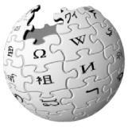

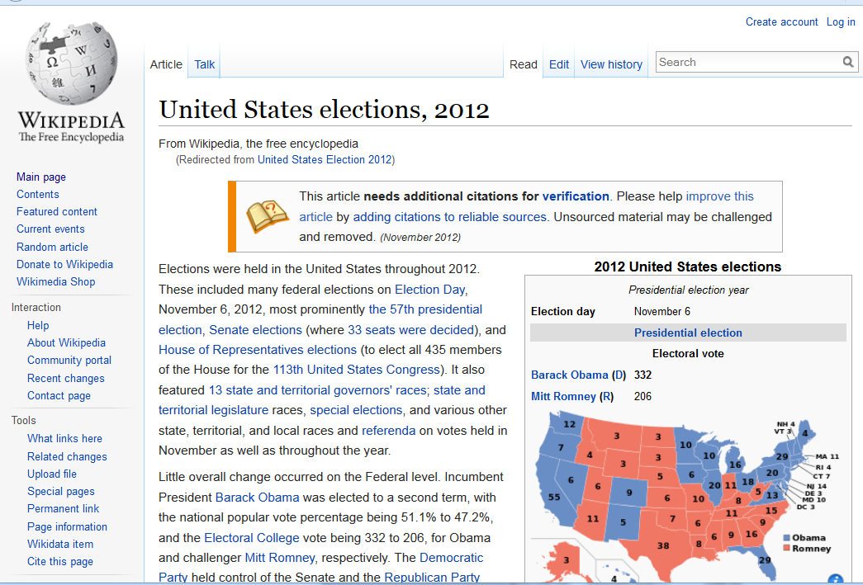
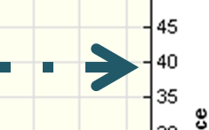
Idea 2 (of 3): A “Future Wikipedia”
 | Wikipedia | Hivemind
Focus | Outcomes of past events. Consensus on known facts. | Outcomes of future events. Future consensus on knowable facts.
Cost | Free to read and edit. | Free to read, easy to understand (check prices), but edits can cost or earn you money.
Learn, in Jan 2011, how unlikely it was that 2012 would be warmest.
Already Happened
Price=40 implies 40%

Slide 6
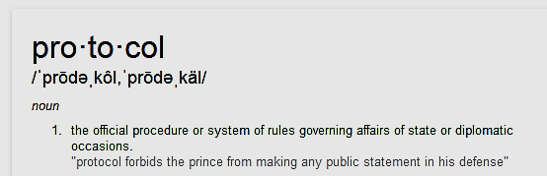
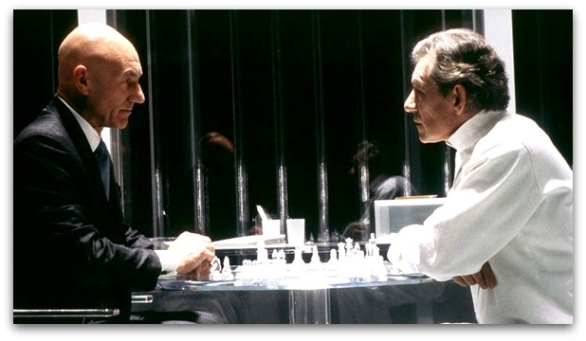
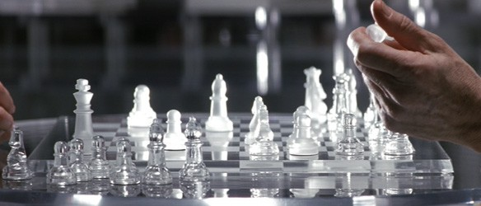
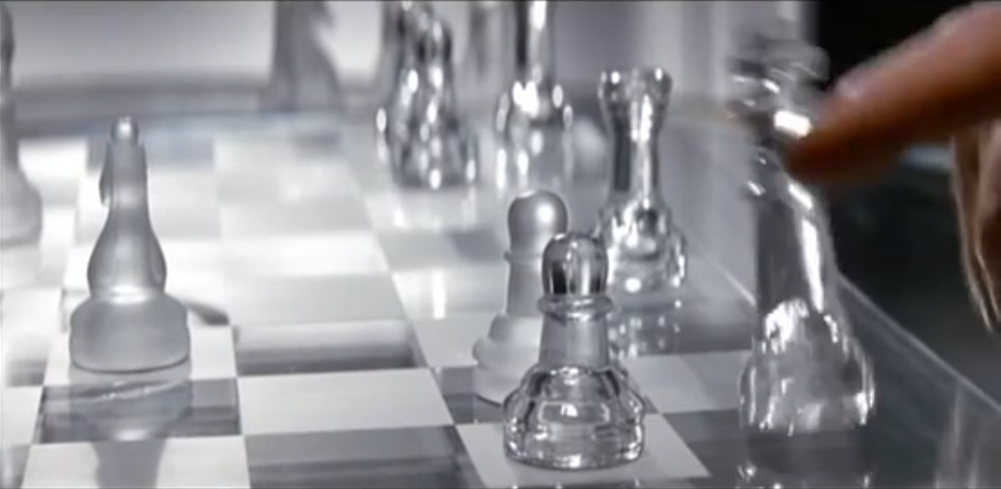
Idea 3 (of 3): A Software ‘Protocol’
What is a ‘protocol’? It’s rules we agree to play by.
Prof X and Magneto Play Chess
Notice: They play “by the rules”
Magneto captures SSE L-wise with his knight. Prof X responds by capturing diagonally with his pawn. Both moves are legal..
ProfX does not try to control Magneto’s thoughts.
Magneto does not try to roll ProfX’s wheelchair away.
If someone, for example, grabbed the game board and threw it over, upsetting the pieces, they would not “win” the game of chess. The game would have simply ‘paused’ (and might still be resumed at a later time by replacing the pieces).
Magneto performs the ‘surrender’ gesture by tipping over his king. The game is now over.

Slide 7
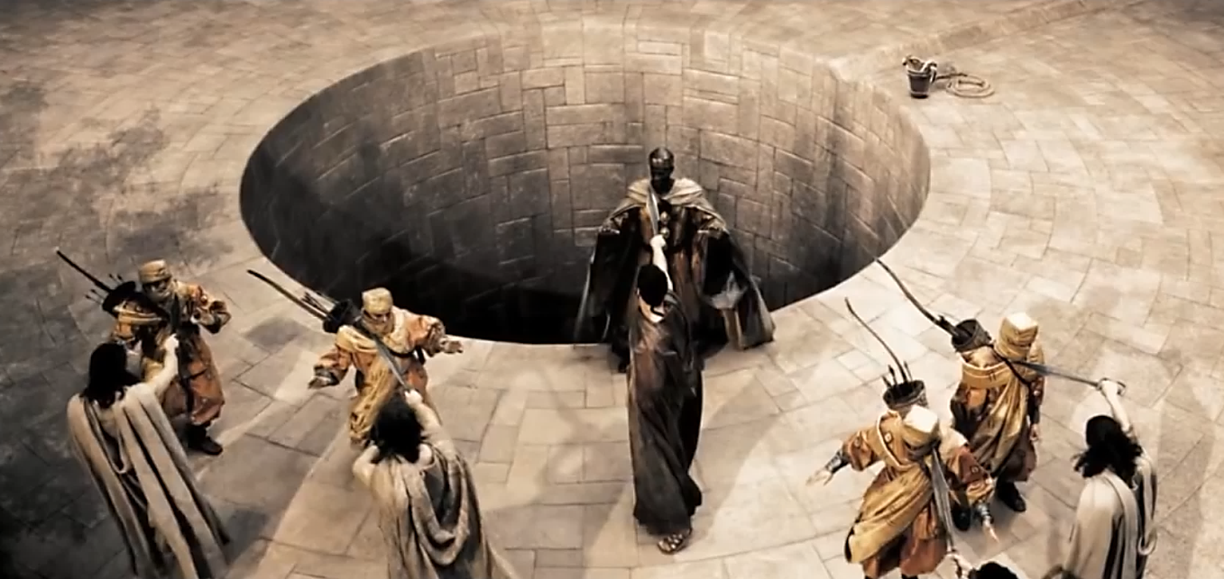
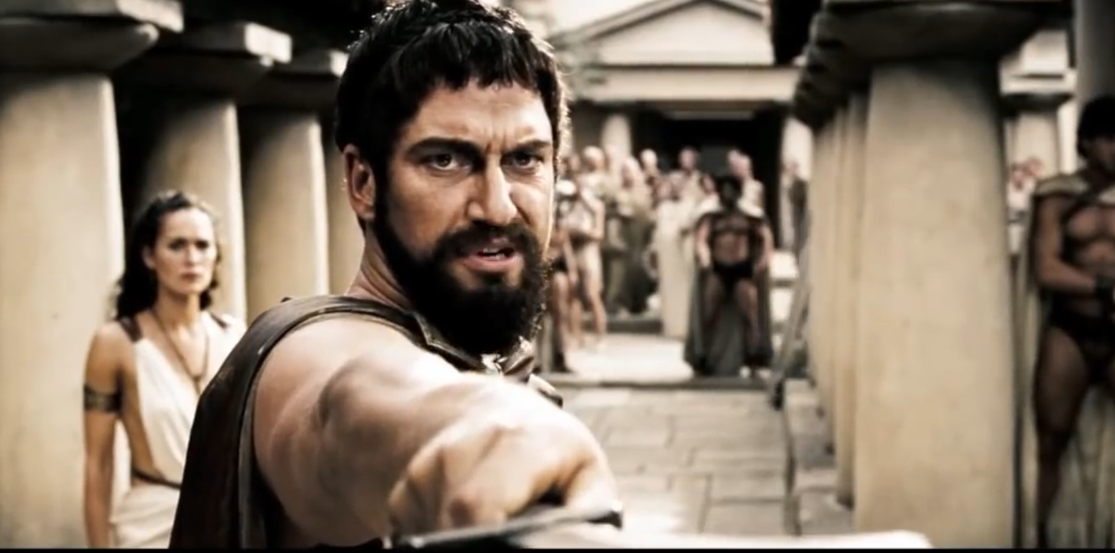
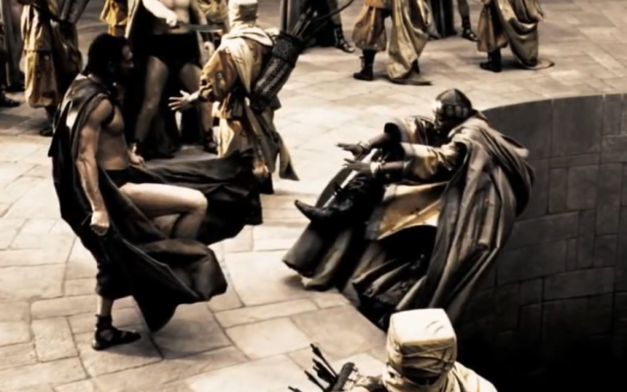
Breach of Protocol
No man, Persian or Greek…
no man threatens a messenger.
You bring the crowns and heads of conquered kings to my city steps. You insult my queen. You threaten my people with slavery and death! Oh, I've chosen my words carefully, Persian. Perhaps you should have done the same!
This is madness!
This is Sparta!
King Leo kicks the messenger into a well. The negotiation protocol (which prevents war) has failed, therefore: War!

Slide 8

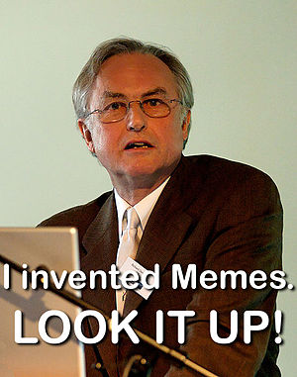
Protocol (Decentralized) | Centralized Non-Protocol
Spoken English | Shakespeare’s Globe Theatre, The Library of Alexandria, MLA Citation Format, Walt Whitman, J.K. Rowling.
Rules to American Football | The NFL, ESPN, The Buffalo Bills.
Bluetooth | A Set of Stereo Speakers, The iPhone 6, A Car Radio Equipped with Bluetooth
Bitcoin | VISA, PayPal, SWIFT, Western Union, Airline Miles, Amazon Coins, e-Gold, Liberty Reserve.
Protocols are Immortal
Protocols are self-replicating “informational viruses” (like memes) which can easily outlive their creator!
Benefits of Immortality:
Will still be around to pay you back (cannot be killed, cannot go out of business).
Tamper/Censorship-Resistant (contracts enforced as signed).
No middlemen (self-sustaining, less overhead, lower cost).
Ankh – Egyptian Symbol of Eternal Life

Slide 9
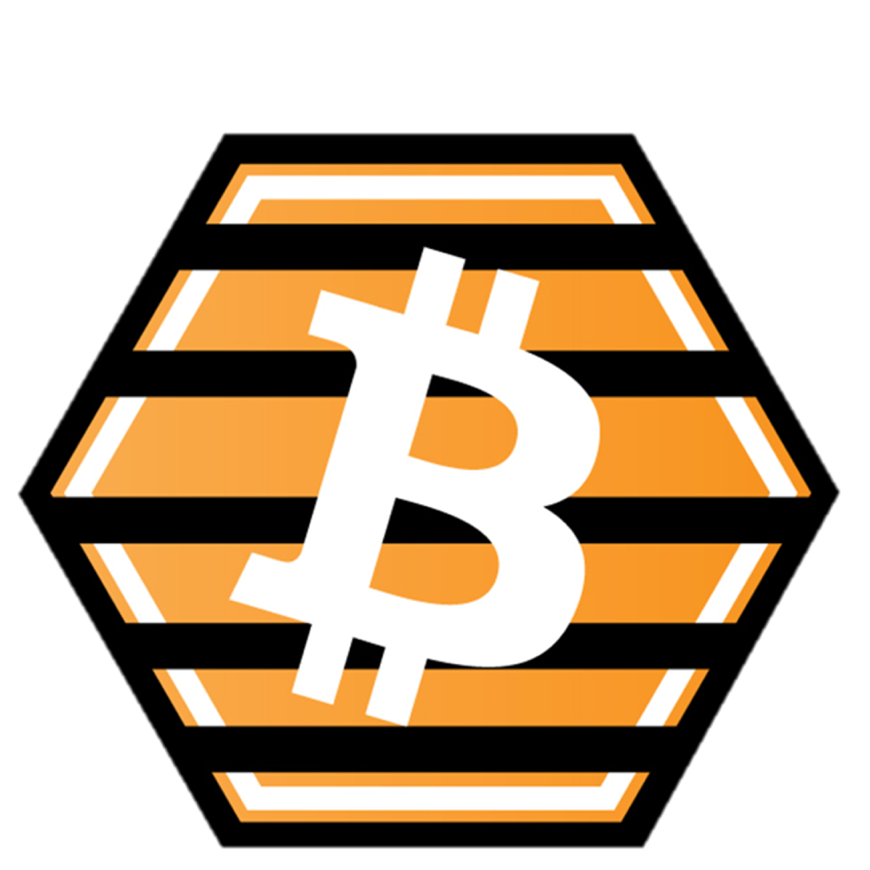



Why Combine These Three?
Items: | 1) Event Derivatives | 2) Future Wikipedia | 3) Bitcoin Protocol
Core Advantage | Optimally-Accurate (Market Efficiency) | Optimally-Open (Anyone can teach/learn) | Optimally-Durable (Can’t be shut off)
Disadvantages | Historically, these businesses (InTrade) close down due to interference, public misunderstanding (betting taboo). Which derivatives to create, and who creates them? | Whose edits are inaccurate? How to aggregate multiple opinions to a single correct answer’? Would Wikipedia really withstand censorship? | Asset markets require third-party trust, do not scale (theft, non-P2P). Accused of having low intrinsic value.

Slide 10
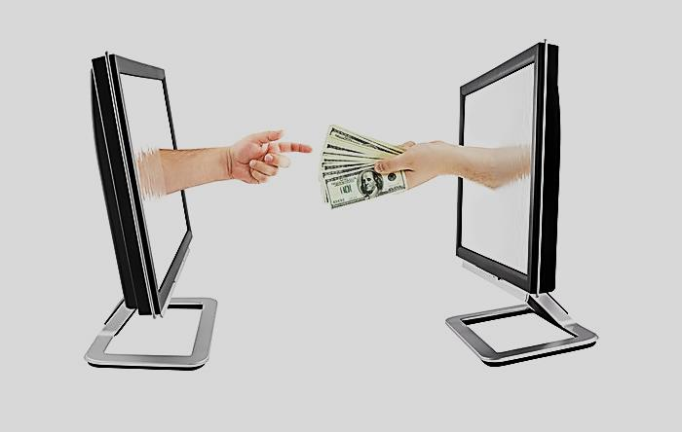

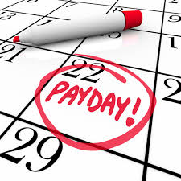
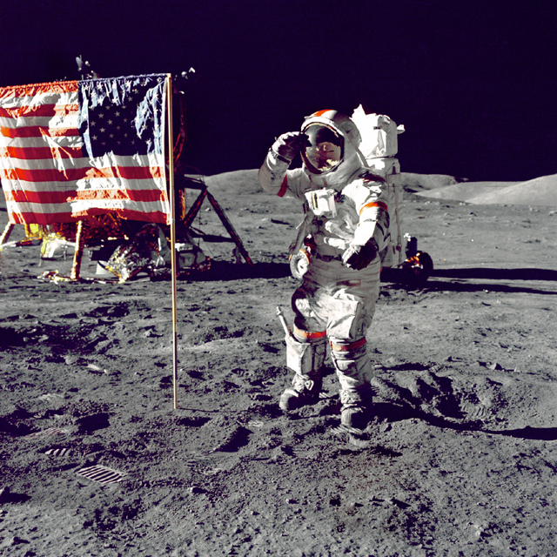
Hivemind – Useful As:
A payment system which transfers money cheaper and faster than Banks/Credit Cards (a LOT cheaper).
The only source of reliable information on the planet!
I’m serious!
A place to work: use your personal experience and expertise to make money!
A community effort in creating a more rational and scientific (“prosperous”) world.
(These are each optional).
Again: I don’t own any of these images.

